Slide 1
Virtual Machine

Slide 2
IaaS Cloud Services
IaaS is an instant computing infrastructure, provisioned and managed over the Internet.

Slide 3
Business Scenarios
Test and Development
Website Hosting
Storage, backup and recovery
Web Apps
High-performance computing
Big data analysis
Extended Datacenter

Slide 4
Planning Checklist
Start with the network
Name the VM
Decide the location for the VM
Determine the size of the VM
Understand the pricing model
Storage for the VM
Operating System

Slide 5
Name the VM
Element | Example
Environment | stg, prod, dev, QA
Location | Uw, ue
Instance | 01, 02, 03, 04, 05
Product or Service | service
Role | Sql, web, messaging
Devusc-webvm01

Slide 6
Location of the VM
The Location can limit your available options
There are price differences between locations

Slide 7
Pricing
Compute Cost: Compute expenses are priced on a per-hour basis but billed on a per-minute basis.
Consumption-based
Reserved Virtual Machine Instances
Storage Cost: Cost of the disk

Slide 8
Virtual Machine Sizing
General Purpose
Compute Optimized
Memory Optimized
Storage Optimized
GPU
High Performance Compute
https://learn.microsoft.com/en-us/azure/virtual-machines/sizes
Note: Be cautious when resizing production VMs

Slide 9
Virtual Machine Disk
OS Disk
Temporary Disk – Non-persistent Storage
Data Disk

Slide 10
Operating System
Windows
Linux

Slide 11
Connect to VM
Windows – RDP - 3389
Linux – SSH - 22

Slide 12
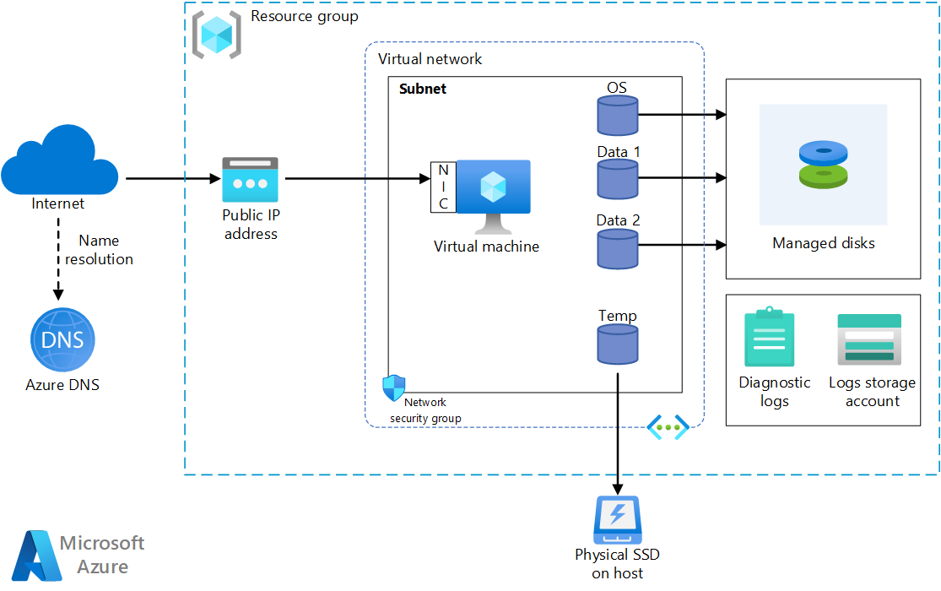
VM Architecture

Slide 13
Stopping the VM
Shutdown
Disconnect
Close the RDP
Stop from Portal
Deallocate

Slide 14
Virtual Machine Availability

Slide 15
Maintenance and Downtime
Unplanned Hardware Maintenance – Live Migration
Unexpected Downtime - Heals
Planned Maintenance – Periodic Updates

Slide 16
High Availability
Availability Sets
Availability Zones
Virtual Machine Scale Set

Slide 17
Service Level Agreements
Single VM with Premium Disk – 99.90%
Availability Sets – 99.95%
Availability Zones – 99.99%

Slide 18


Availability Sets
Logical feature used to ensure that a group of related VMs are deployed so that they are not all subjected to a single point of failure.

Slide 19


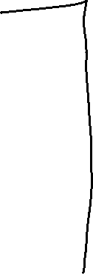
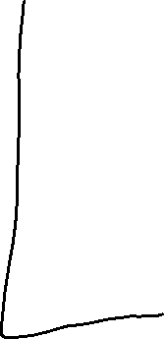

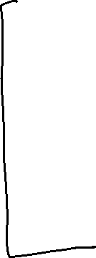

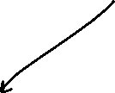
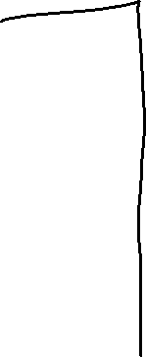






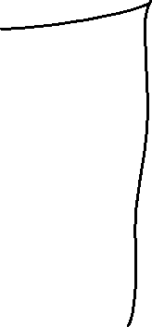



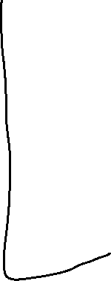






Slide 20
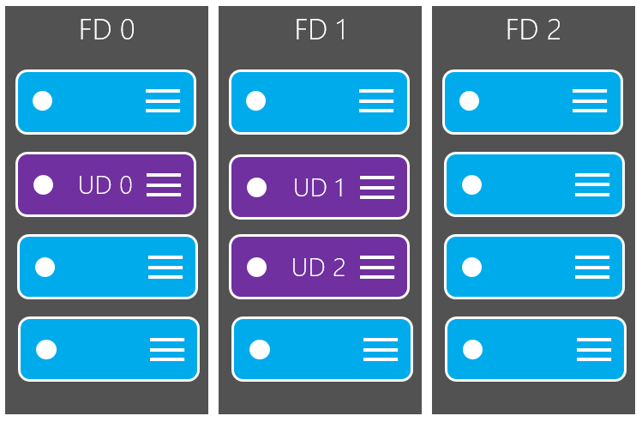
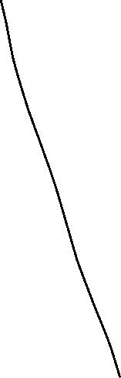
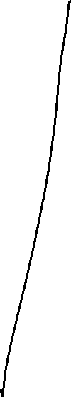


Slide 21

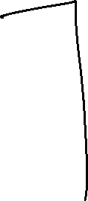

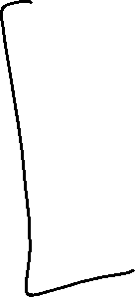
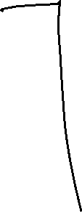

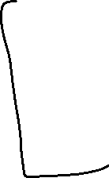




Slide 22

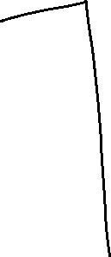
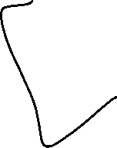


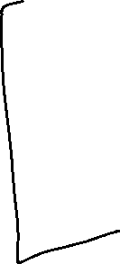


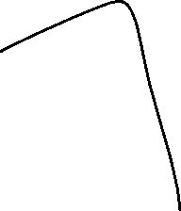

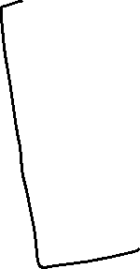


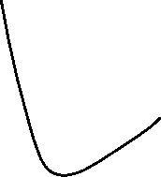
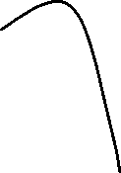
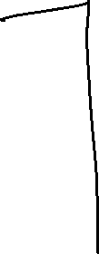


Slide 23
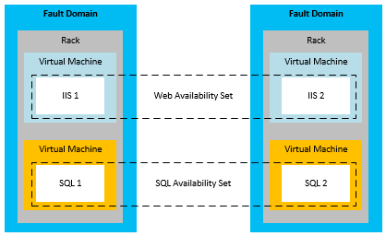


Slide 24
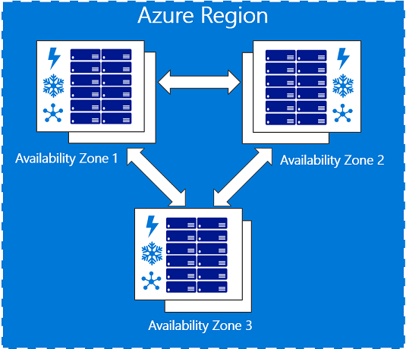
Availability Zones

Slide 25
Virtual Machine Scale Set

Slide 26
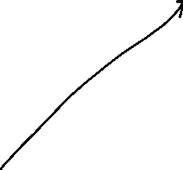




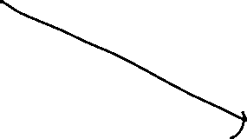

Scale Sets
Virtual Machine Scale Sets are used to deploy and manage a set of identical VMs.
Designed to support True auto-scale no-pre-provisioning of VMs required

Slide 27
Benefits
Same base OS image and configuration
Layer 4 and Layer 7 Load Balancer/ traffic distribution
Scale Out
Scale In
Support upto 1000VMs

